Slide 1

REMITTANCE PATTERNS AND ECONOMIC DEVELOPMENT
HDSC SPRING'23
25th August 2023
Team Catboost

Slide 2


TEAM CATBOOST
OTHER ACTIVE MEMBERS
Arundarasi Rajendran
Anih Nathan Chizoba
Adeniyi Olaolu Peter
Akinade Phillip Akintoye
Olalekan Okewale
Ibrahim Abdulsalam Abdullahi
INCREASE CHRISTIAN
Etietop Udofia
Carla Bailón Rosas
Akanbi Abiodun
Kawonise Abdullateef
Joseph Ngota Chilo
Abdulkareem Sikirulahi Opeyemi
Bamiteko Ibiduni Adekemi
Sunday Kingsley
Benjamin Lawani
PRESENTER 1
PRESENTER 2
Anih Nathan Chizoba
Miracle Uche
Project Lead
Confidence Chinelo Ojiako
Assistant Project Lead
Deya Chatterjee
Query Analyst
Miracle Uche

Slide 3
PROBLEM STATEMENT
Remittance is the transfer of money by a foreign worker to an individual in their home country. Remittances have been found to have a positive impact on economic development in developing countries. According to a study by SpringerLink, remittance inflows spur economic growth not only in low- and middle-income countries but also in high-income countries. However, the study also found that remittance inflows increase unemployment in high-income countries while reducing it in low- and middle-income countries. The study also validated the income inequality mitigating role of remittance inflows across all countries
Hence this project seeks to:
Develop a machine learning model
Justify the relationships between remittance and other economic factors

Slide 4
EXISTING SOLUTION
The study of the relationship between remittance inflows and per capita income growth focused on Small Island Developing States (SIDS) using econometric analysis of data for 136 developing countries, including 25 SIDS, for the period 1971 to 2010.
The impact of worker remittances on economic growth of Albania and five regional countries using annual panel data from 1999–2013.
The study conducted by a team of interns at Hamoye AI Lab known as Team Bayes (HDSC WINTER, 2023). The team carried out research on the effect of remittance patterns on economic development.

Slide 5
OUR APPROACH
This project stands out in its approach as it steadily and meticulously:
Prepared the data
Explored and gather hypothesis testing with python library, EDA with python and Power BI
Performed feature engineering
Iterate through
Build machine learning models
Evaluate the models
Ensemble a combination of high performing models
Deploy the best model

Slide 6
DATASET DESCRIPTION
The entire dataset was obtained from the World Bank website. It comprised five separate datasets that were merged to serve the purpose of this study.
Remittance Received: The dataset contain variables such as; country name and remittance inflow to those countries from 1960 to 2022.
Remittance Paid: The dataset contain variables such as country name and remittance outflow from those countries from 1960 to 2022.
Population: The dataset contains country names and population size of those countries from 1960 to 2022.
GDP: The dataset contains country names and GDP of countries from 1960 to 2022.
Unemployment Rate: The dataset contains country names and unemployment rate from 1960 to 2022.
Net-Migration: The dataset contains country names and their net migration from 1960 to 2022. Net migration is the number of immigrants minus the number of emigrants in a country. This value can be negative.

Slide 7
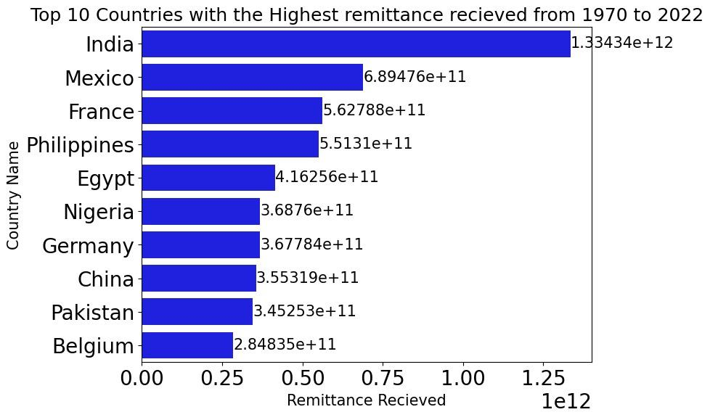
EXPLORATORY DATA ANALYSIS
Click here for more

Slide 8
FURTHER VISUALIZATION ON POWER BI
Click here for more

Slide 9
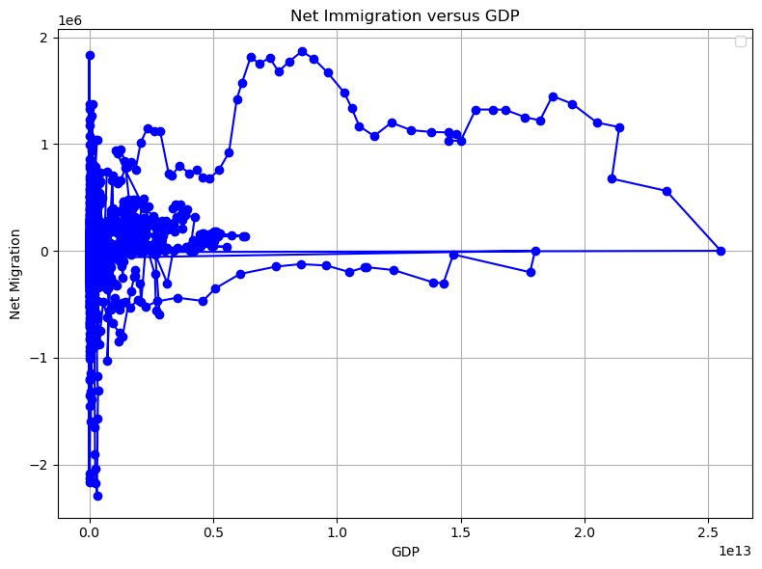
HYPOTHESIS TESTING
Change in net immigration will mean increase in remittance received
GDP grows as as people flock into a country (positive net migration) than when people leave (negative migration)

Slide 10
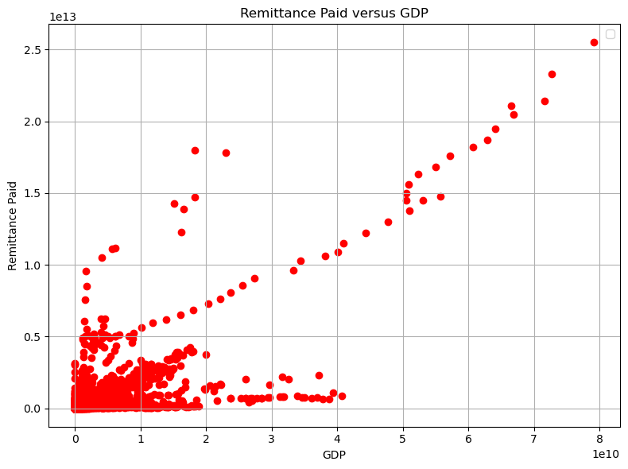
HYPOTHESIS TESTING
Change in remittance paid causes change in GDP of a country
As the Remittance paid Increase also increase the GDP

Slide 11
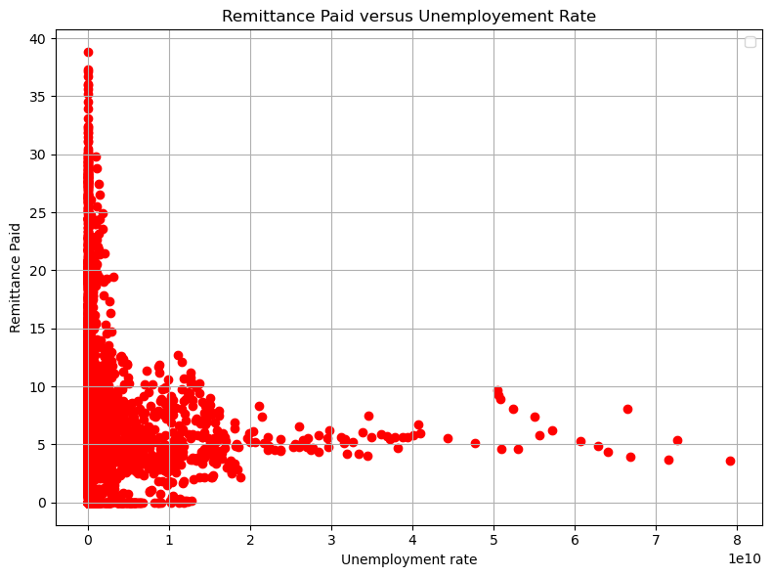
HYPOTHESIS TESTING
Change in remittance paid causes change in unemployment rate in a country
When a remittance paid increase the unemployment rate decrease.

Slide 12
FEATURE ENGINEERING
For the purpose of a more detailed analysis, feature engineering was carried out to add features such as remittance_growth_rate, remittance_per_capita, remittance_volatility, remittance_to_gdp_ratio, remittance growth rate, and unemployment rate change.

Slide 13
MODEL PIPELINE
DATA SOURCING
DATA PREPARATION
FEATURE
ENGINEERING
MODEL DEVELOPMENT
MODEL DEPLOYMENT
MODEL EVALUATION

Slide 14
MODEL DEVELOPMENT
Data Cleaning and Preprocessing
Replace infinite values, drop unnecessary columns, working with 0 values.
Exploratory Data Analysis
Histograms, distribution analysis, time serie plot,trend plots.
Working with Categorical and Numerical Columns
Min Max Scaler for numerical columns, Label encoding for categorical columns.
Train - test split, working with selected variables, Training the regressors :, Random Forest, XGBoost, Support Vector Regressor (SVR) and Stochastic Gradient Descent (SGD) with parameter tuning.
Training the model using various algorithms

Slide 15
MODEL EVALUATION
Findings revealed that the XGBoost model performs very
well across all metrics for GDP, Remittance to GDP ratio and the unemployment rate predictions. The low values of MSE, MAE, RMSE, and the high R2 indicate accurate predictions and a good fit to the data. Concerning SVR and SGD, these models also show competitive performance with relatively low MSE, MAE, and RMSE values. The R2 values suggest that they explain a good portion of the variance, but they might not be as accurate as XGBoost. The Random Forest seems to perform less well than the
other models.

Slide 16
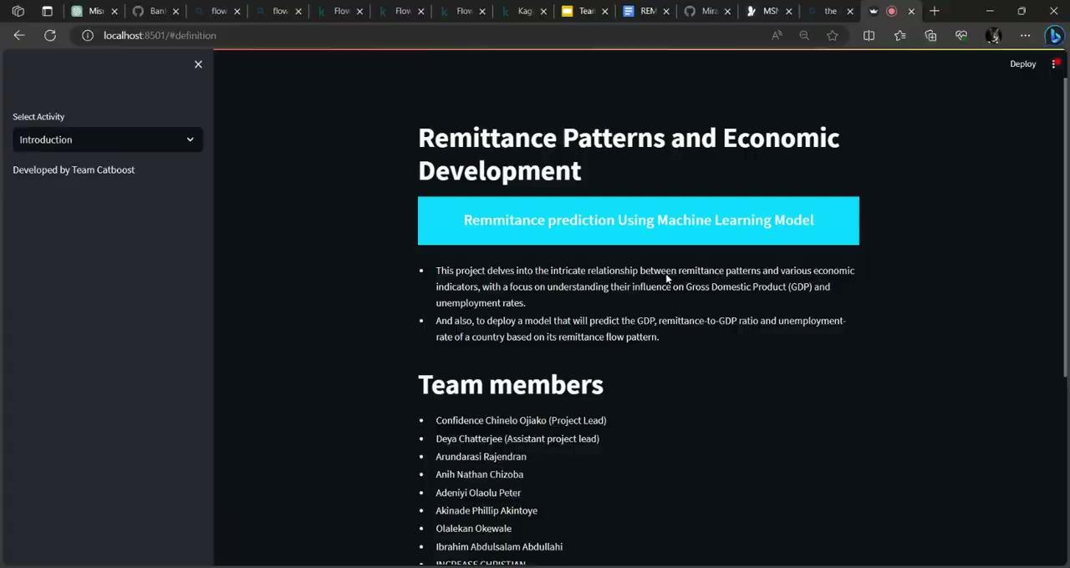
MODEL DEPLOYMENT

Slide 17
SUMMARY
Through meticulous data analysis, including preprocessing and feature engineering, various machine learning models were employed to predict economic indicators like GDP and unemployment rate. The findings showcased the XGBoost model's outstanding accuracy, followed by competitive performances from SVR and SGD models. Although the Random Forest model exhibited weaker results, it still captured notable GDP variance.
CHALLENGES
Working with additional datasets from World Bank.
The lack of data about GDP, remittance and other features from 1970 to 1980 in some countries.

Slide 18
RELATED LINKS
Presentation Slides here
This project is hosted on Github
The project is deployed on Sreamlit
Model Development on Github
Exploratory Data Analysis on Github
Hypothesis Testing on GitHub
Documentation and Research paper
The dashboard is deployed on Power Bi

